Slide 1
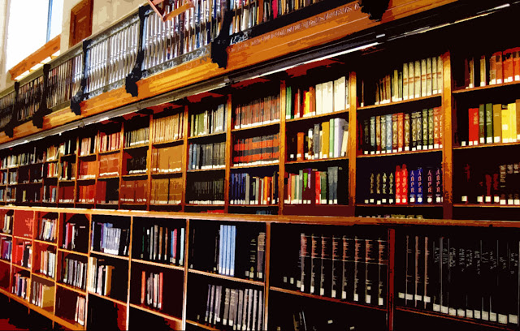
Digital Library System
J. Jyothi Priya
192211978
Dr. K. Jayasakthi Velmurugan

Slide 2

Introduction to the Digital Library System
Welcome to the presentation outlining the proposed digital library system. This system will revolutionize how users access and interact with our library's resources.
Page no:2

Slide 3
Agenda
1
Introduction
A brief overview of the digital library system and its purpose.
2
Objective
Discussing the primary goals and aims of the digital library system.
3
Existing System & Drawbacks
Examining the limitations of the current library system.
4
Proposed System & Advantages
Presenting the new digital library system and its benefits.
5
System Architecture
Illustrating the technical design and components of the system.
6
Modules & Descriptions
Exploring the different modules of the system and their functions.
7
Conclusion & Enhancements
Summarizing the key takeaways and future development plans.
8
References
Listing the sources used for this presentation.
Page no: 3

Slide 4
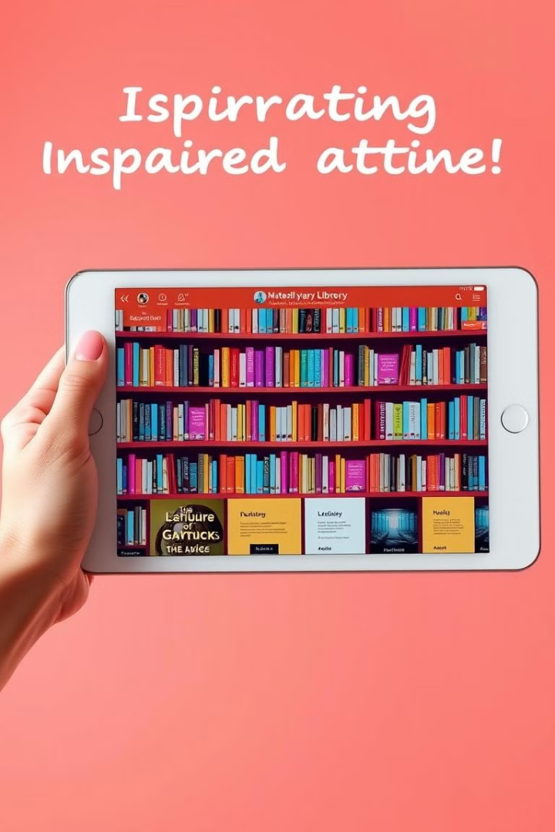
Objective of Digital Library System
Enhanced Accessibility
Improved Search & Discovery
Providing 24/7 access to library resources from anywhere with an internet connection.
Simplifying the search process and making it easier to find relevant materials.
Personalized Recommendations
Increased Engagement
Promoting interaction and fostering a more engaging library experience.
Offering tailored suggestions based on user interests and browsing history.
Page no: 4

Slide 5
Existing System and Its Drawbacks
Physical Constraints
Inefficient Search
Limited Resources
Limited space for housing books and accommodating users. Restricted access hours.
Manual cataloging and searching can be time-consuming and frustrating.
Restricted access to online resources, such as ebooks and digital journals.
Page no: 5

Slide 6
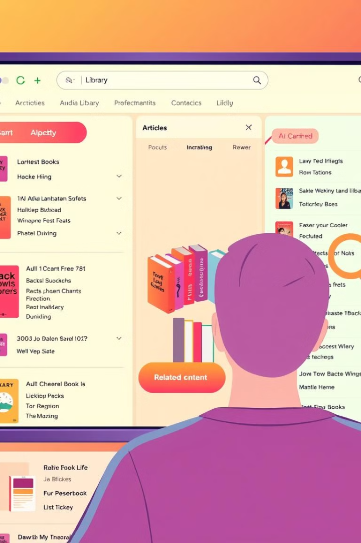
Proposed System and Its Advantages
1
Unlimited Storage
2
Advanced Search Functionality
Digital storage allows for a vast collection of books, articles, and multimedia resources.
Advanced search filters and keyword search capabilities enhance resource discovery.
3
Remote Access
4
Enhanced User Experience
Users can access the library from anywhere with an internet connection, eliminating physical limitations.
Interactive features, personalized recommendations, and streamlined interfaces improve the user experience.
Page no: 6

Slide 7
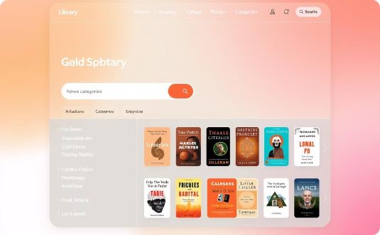
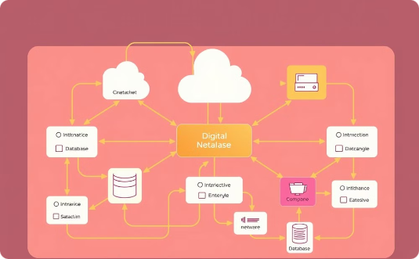
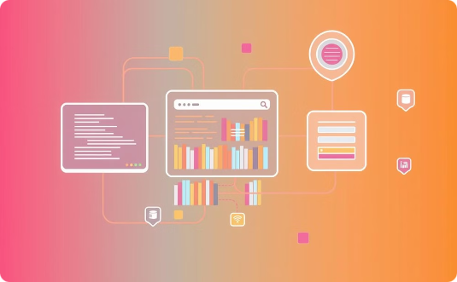
Architecture Diagram
User Interface
System Infrastructure
Data Flow
A user-friendly interface for browsing, searching, and accessing resources.
The underlying hardware and software infrastructure supporting the system.
The process of data exchange between the user interface, search engine, and database.
Page no: 7

Slide 8

Listed Modules
User Management
Content Management
Search Engine
Digital Collections
Digital Rights Management
Analytics & Reporting
Page no: 8

Slide 9






Each Module Description and Output
User Management
Handles user registration, login, and account management, including access control and user privileges.
Content Management
Manages the collection of digital resources, including metadata, digitization, and preservation.
Search Engine
Provides advanced search capabilities, indexing resources, and retrieving relevant results based on user queries.
Digital Collections
Organizes and manages digital resources, including books, articles, multimedia files, and other materials.
Digital Rights Management
Protects digital resources from unauthorized access and use, ensuring compliance with copyright laws.
Analytics & Reporting
Tracks user activity, usage patterns, and system performance, providing valuable insights for optimization.
Page no: 9

Slide 10
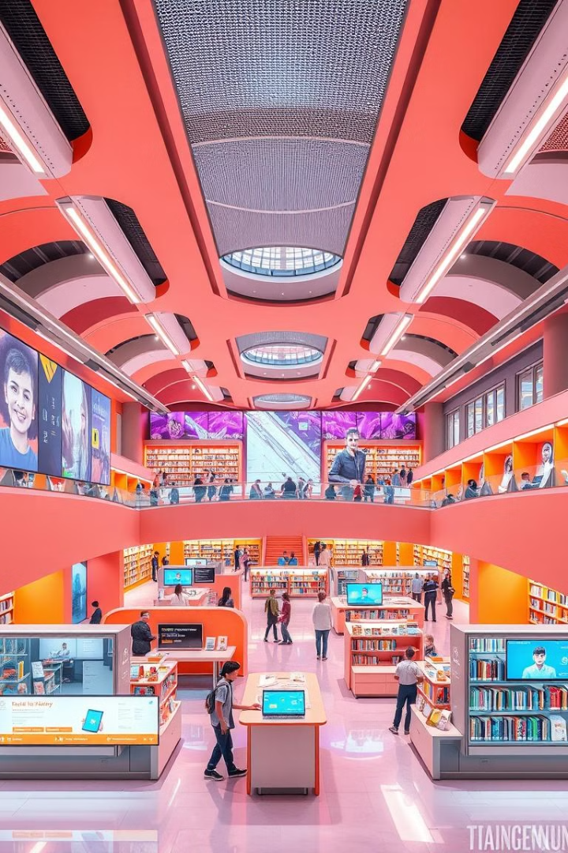




Conclusion and Future Enhancement
Enhanced Accessibility
Improved Search Functionality
The digital library system provides 24/7 access to resources from anywhere with an internet connection.
Advanced search capabilities enhance resource discovery, simplifying the process for users.
Personalized Recommendations
Future Enhancements
Tailored suggestions based on user interests and browsing history improve engagement.
Future development plans include integrating augmented reality, virtual reality, and artificial intelligence technologies to further enhance the user experience and provide innovative learning opportunities.
Page no: 10

Slide 11
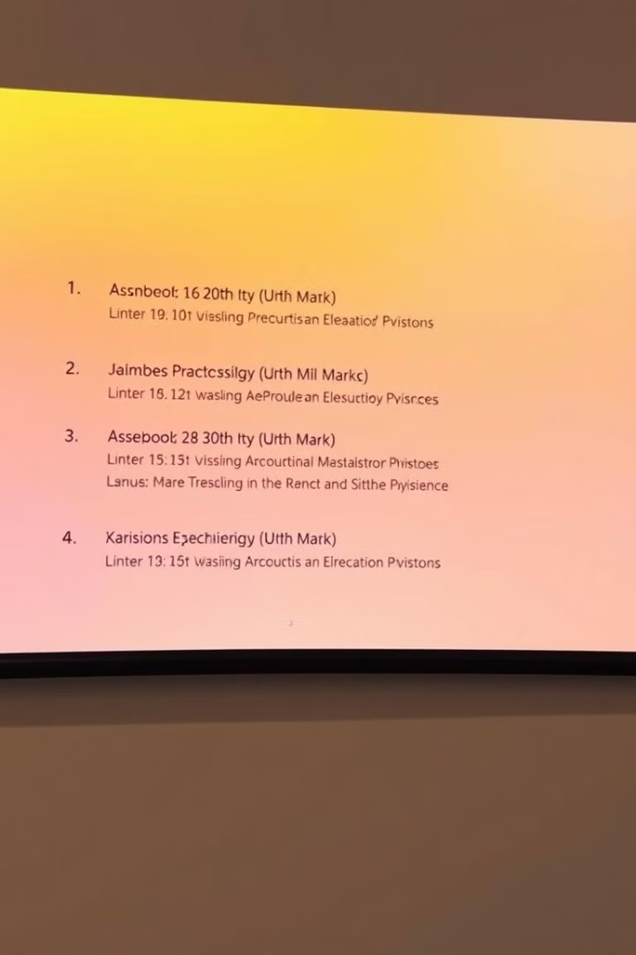
Reference
The information presented in this presentation is based on various research papers, articles, and industry best practices related to digital library systems. This presentation is intended for informational purposes and does not represent any specific product or service.
Page no: 11

Slide 12


